Slide 1
Morphological Image Processing

Slide 2
Application
Erosion

Slide 3
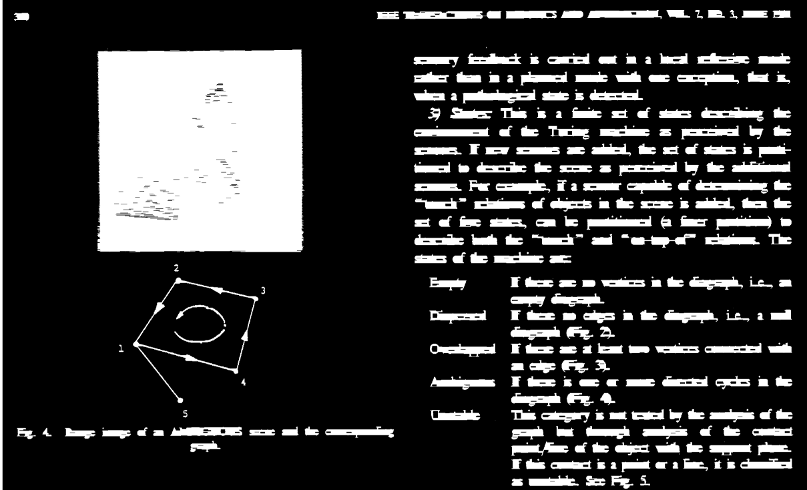
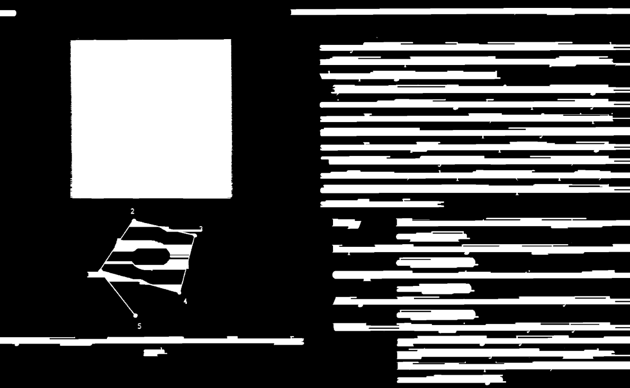
Application
Dilation

Slide 4
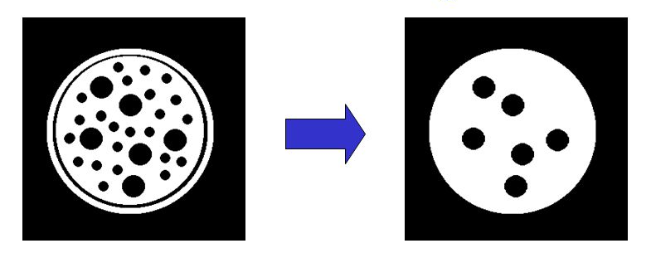
Morphological Operation
Non-linear operations related to the shape or morphology of features in an image
On Binary Images

Slide 5
Structuring Element
A small shape or template called a structuring element, a matrix that identifies the pixel in the image being processed and defines the neighborhood used in the processing.

Slide 6
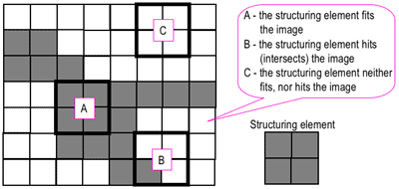
Structuring Element
Hit, Fit or Miss

Slide 7
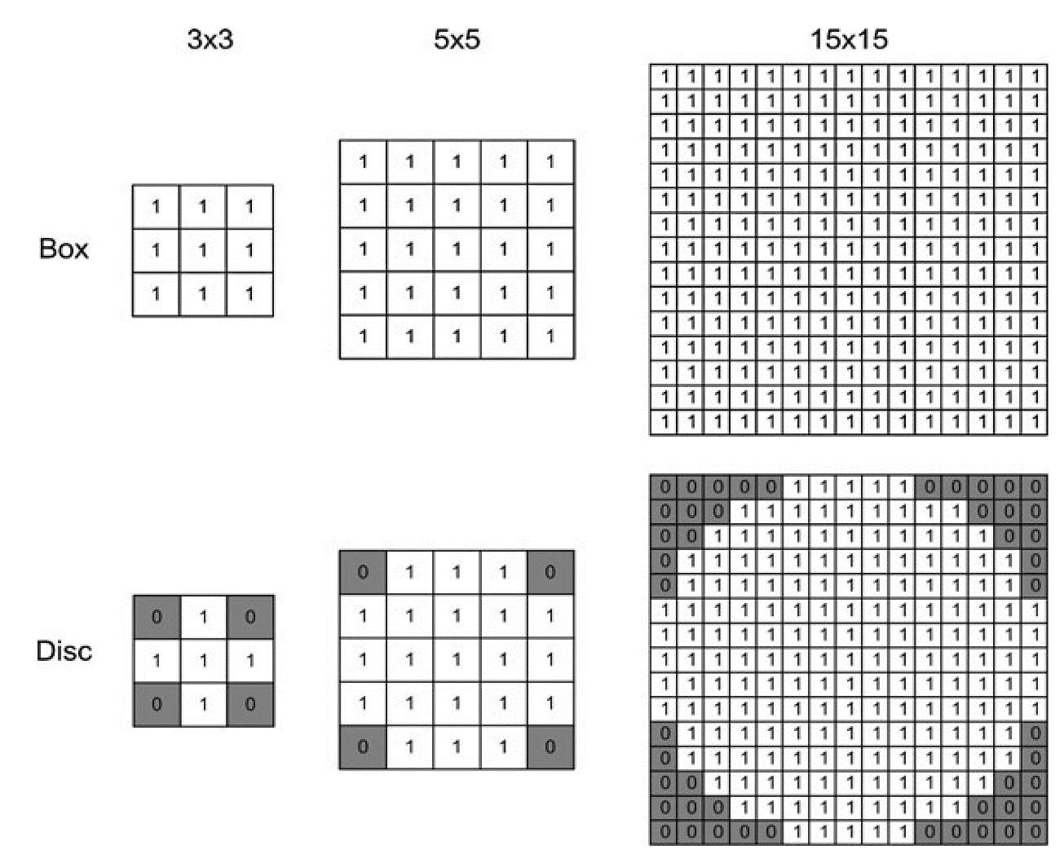
Different Types of Structuring Element

Slide 8
Example for Dilation
Input image
1 | 0 | 0 | 0 | 1 | 1 | 1 | 0 | 1 | 1
Structuring Element
1
1
1
Output Image
 | 1
8

Slide 9
Example for Dilation
Input image
1 | 0 | 0 | 0 | 1 | 1 | 1 | 0 | 1 | 1
Structuring Element
1
1
1
Output Image
 | 1 | 0
9

Slide 10
Example for Dilation
Input image
1 | 0 | 0 | 0 | 1 | 1 | 1 | 0 | 1 | 1
Structuring Element
1
1
1
Output Image
 | 1 | 0 | 1
10

Slide 11
Example for Dilation
Input image
1 | 0 | 0 | 0 | 1 | 1 | 1 | 0 | 1 | 1
Structuring Element
1
1
1
Output Image
 | 1 | 0 | 1 | 1
11

Slide 12
Example for Dilation
Input image
1 | 0 | 0 | 0 | 1 | 1 | 1 | 0 | 1 | 1
Structuring Element
1
1
1
Output Image
 | 1 | 0 | 1 | 1 | 1
12

Slide 13
Example for Dilation
Input image
1 | 0 | 0 | 0 | 1 | 1 | 1 | 0 | 1 | 1
Structuring Element
1
1
1
Output Image
 | 1 | 0 | 1 | 1 | 1 | 1
13

Slide 14
Example for Dilation
Input image
1 | 0 | 0 | 0 | 1 | 1 | 1 | 0 | 1 | 1
Structuring Element
1
1
1
Output Image
 | 1 | 0 | 1 | 1 | 1 | 1 | 1
14

Slide 15
Example for Dilation
Input image
1 | 0 | 0 | 0 | 1 | 1 | 1 | 0 | 1 | 1
Structuring Element
1
1
1
Output Image
 | 1 | 0 | 1 | 1 | 1 | 1 | 1 | 1
15

Slide 16
Example for 1D Erosion
Input image
1 | 0 | 0 | 0 | 1 | 1 | 1 | 0 | 1 | 1
Structuring Element
1
1
1
Output Image
 | 0

Slide 17
Example for 1D Erosion
Input image
1 | 0 | 0 | 0 | 1 | 1 | 1 | 0 | 1 | 1
Structuring Element
1
1
1
Output Image
 | 0 | 0

Slide 18
Example for 1D Erosion
Input image
1 | 0 | 0 | 0 | 1 | 1 | 1 | 0 | 1 | 1
Structuring Element
1
1
1
Output Image
 | 0 | 0 | 0

Slide 19
Example for 1D Erosion
Input image
1 | 0 | 0 | 0 | 1 | 1 | 1 | 0 | 1 | 1
Structuring Element
1
1
1
Output Image
 | 0 | 0 | 0 | 0

Slide 20
Example for 1D Erosion
Input image
1 | 0 | 0 | 0 | 1 | 1 | 1 | 0 | 1 | 1
Structuring Element
1
1
1
Output Image
 | 0 | 0 | 0 | 0 | 1

Slide 21
Example for 1D Erosion
Input image
1 | 0 | 0 | 0 | 1 | 1 | 1 | 0 | 1 | 1
Structuring Element
1
1
1
Output Image
 | 0 | 0 | 0 | 0 | 1 | 0

Slide 22
Example for 1D Erosion
Input image
1 | 0 | 0 | 0 | 1 | 1 | 1 | 0 | 1 | 1
Structuring Element
1
1
1
Output Image
 | 0 | 0 | 0 | 0 | 1 | 0 | 0

Slide 23
Example for 1D Erosion
Input image
1 | 0 | 0 | 0 | 1 | 1 | 1 | 0 | 1 | 1
Structuring Element
1
1
1
Output Image
 | 0 | 0 | 0 | 0 | 1 | 0 | 0 | 0

Slide 24
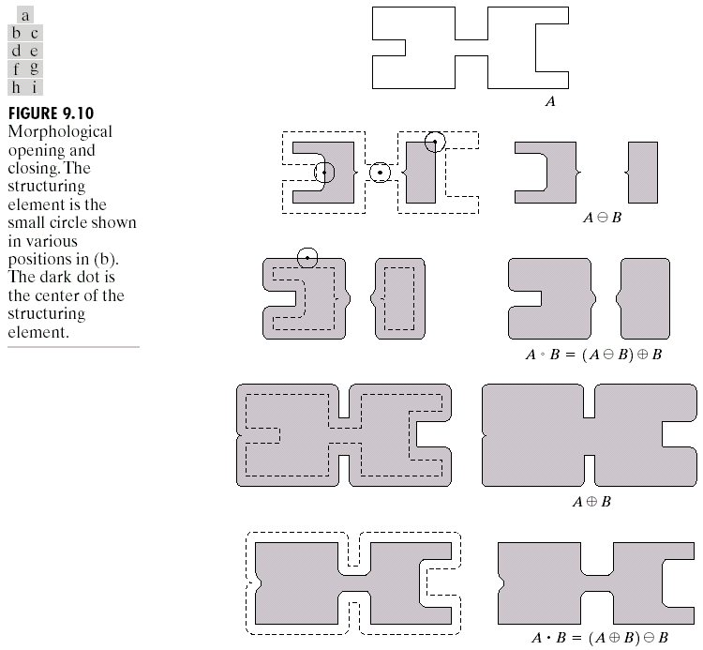
Opening
The opening of image A by structuring element B, denoted by A○B is simply an erosion followed by a dilation
Original shape
After erosion
After dilation (opening)
24
Notes:
24

Slide 25

Opening

Slide 26
Closing
The closing of image f by structuring element s, denoted by f • s is simply a dilation followed by an erosion
Original shape
After dilation
After erosion (closing)
26
Notes:
26

Slide 27

Closing

Slide 28
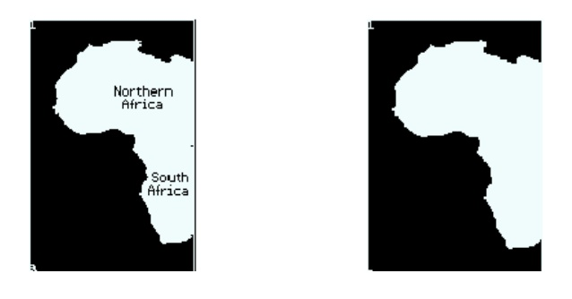
Exercise: Which one should we apply here?

